Slide 1
Software Engineering Individual Project
Tiles
Week 9 Presentation
- Saurabh Pathak

Slide 2
Quick Recap of the game
The game will present a 2X2 matrix of tiles.
Each tile will have a unique number or a pattern hidden behind it.
Each unique number/pattern exists twice in the matrix.
Once the player taps a tile, it flips and shows the pattern behind it.
The player has to match (by tapping consecutively) two tiles with same number/pattern hidden behind them.
If you match two tiles with different pattern, both the tiles will rotate and hide the pattern behind them.

Slide 3
core elements
2D matrix of tiles
Timer as per level
Patterns which will get complicated as per level
Retaining last state of the game

Slide 4
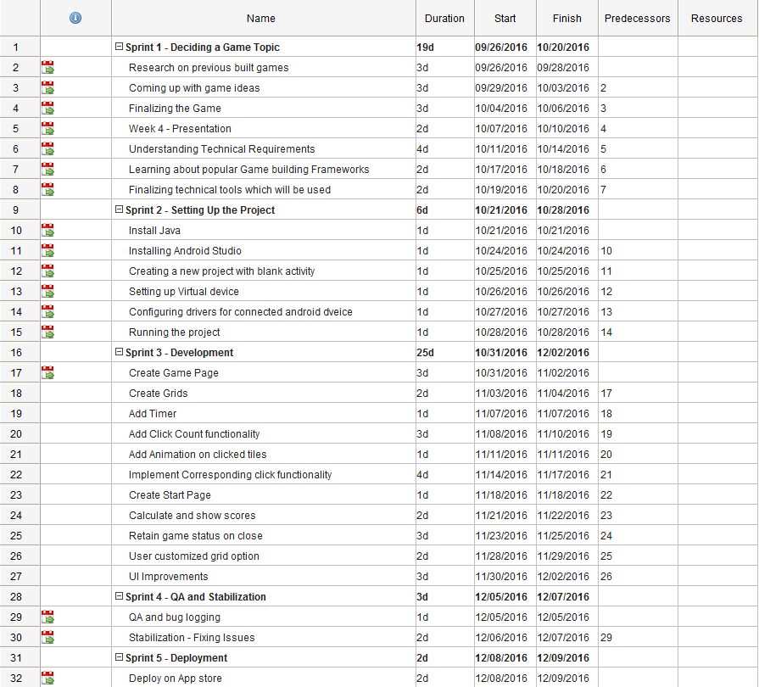
Planning and management
Click here for complete Gantt chart

Slide 5
Progress So Far
The Game works!!!
A static 2D matrix of 20 tiles has been implemented.
Counter for number of clicks works as per requirements.
The timer records the time starting with the first click.

Slide 6
Project Status as per gantt chart
For now the project is on schedule.
Pending Enhancements are - User specific grid size. - Retaining game state if in case user has to close the game in between. - User Customized Grid option - UI improvements

Slide 7
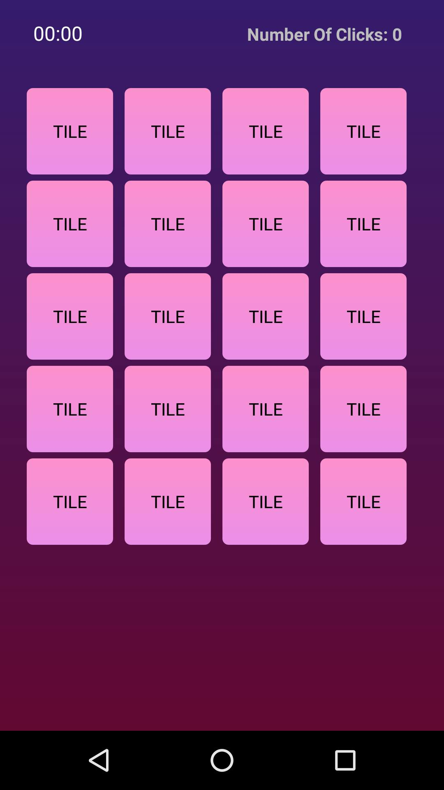
User Interface of the Game
Initial screen after starting game

Slide 8
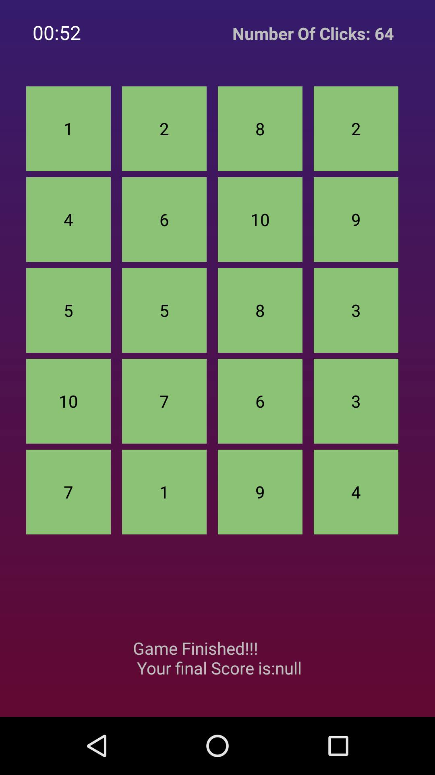
User Interface of the Game
Game completion screen

Slide 9
Thank you!

